Slide 1



Overview of Patterns: Part 1
Douglas C. Schmidt
d.schmidt@vanderbilt.edu
www.dre.vanderbilt.edu/~schmidt
Professor of Computer Science
Institute for Software Integrated Systems Vanderbilt University Nashville, Tennessee, USA

Slide 2

Topics Covered in this Part of the Module
Motivate the importance of design experience & leveraging recurring design structure in becoming a master software developer
Notes:
Another Flying sidekick, http://www.flickr.com/photos/34745138@N00/2756361218/

Slide 3



Becoming a Master
Experts perform differently than beginners
e.g., unlike novices, professional athletes, musicians, & dancers move fluidly & effortlessly, without focusing on each individual movement
Notes:
http://www.flickr.com/photos/34128007@N04/5424645668/sizes/l/, http://www.flickr.com/photos/barbara-pictures/6975100728/sizes/l/, http://www.flickr.com/photos/54452028@N00/3600002571/

Slide 4

Becoming a Master
Experts perform differently than beginners
e.g., unlike novices, professional athletes, musicians, & dancers move fluidly & effortlessly, without focusing on each individual movement
When watching experts perform it’s easy to forget how much effort they’ve put into reaching high levels of achievement
Notes:
http://www.flickr.com/photos/15817797@N00/346990046/

Slide 5


Becoming a Master
Experts perform differently than beginners
e.g., unlike novices, professional athletes, musicians, & dancers move fluidly & effortlessly, without focusing on each individual movement
When watching experts perform it’s easy to forget how much effort they’ve put into reaching high levels of achievement
Continuous repetition & practice is crucial to success
Mentoring from other experts is also essential to becoming a master
Notes:
http://www.flickr.com/photos/58982967@N00/22351699/, http://www.flickr.com/photos/26474941@N00/411982133/

Slide 6
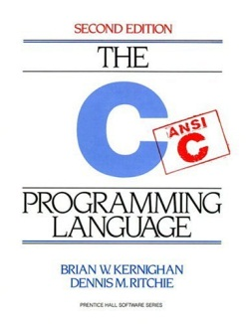


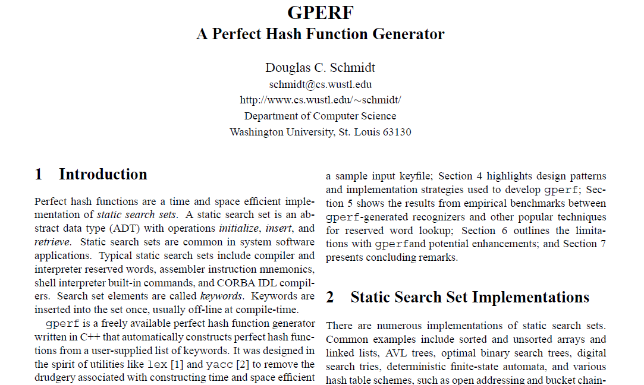

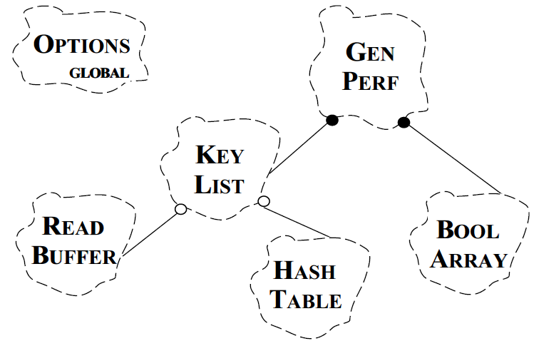

Becoming a Master Software Developer
Knowledge of programming languages is necessary, but not sufficient
Can fall prey to “featuritis” or worse
e.g., GPERF perfect hash function generator, circa 1990
Notes:
http://www.ioccc.org/

Slide 7

Becoming a Master Software Developer
Knowledge of programming languages is necessary, but not sufficient
Can fall prey to “featuritis” or worse
e.g., GPERF perfect hash function generator, circa 1990
Problems
Hard-coded algorithms
Hard-coded data structures
Hard-coded generators
etc.
See www.dre.vanderbilt.edu/~schmidt/PDF/gperf.pdf for a paper on GPERF
Notes:
http://www.ioccc.org/

Slide 8

Becoming a Master Software Developer
Knowledge of programming languages is necessary, but not sufficient
Can fall prey to “featuritis” or worse
e.g., GPERF perfect hash function generator, circa 1990
GPERF is part of the GNU software release at www.gnu.org/software/gperf
Notes:
http://www.ioccc.org/

Slide 9

Becoming a Master Software Developer
Knowledge of programming languages is necessary, but not sufficient
Can fall prey to “featuritis” or worse!
e.g., “Best one-liner” from 2006 “Obfuscated C Code” contest
This program prints out the time when it was compiled!
main(_){_^448&&main(-~_);putchar(--_%64?32|-~7[ __TIME__-_/8%8][">'txiZ^(~z?"-48]>>";;;====~$::199" [_*2&8|_/64]/(_&2?1:8)%8&1:10);}
See www.ioccc.org for many examples of obfuscated C
Notes:
http://www.ioccc.org/

Slide 10
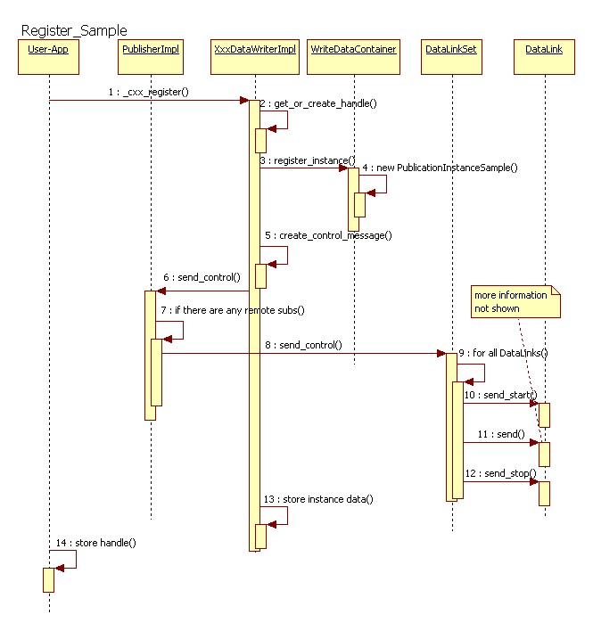
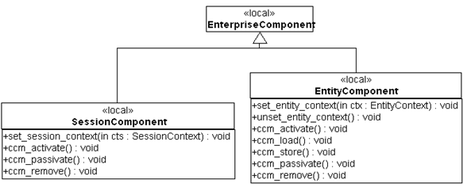
Becoming a Master Software Developer
Knowledge of programming languages is necessary, but not sufficient
Can fall prey to “featuritis” or worse!
Software methods emphasize design notations, such as UML
Fine for specification & documentation
e.g., omits mundane implementation details & focuses on relationships between key design entities

Slide 11

Becoming a Master Software Developer
Knowledge of programming languages is necessary, but not sufficient
Can fall prey to “featuritis” or worse!
Software methods emphasize design notations, such as UML
Fine for specification & documentation
But good software design is more than drawing diagrams
Good draftsmen/artists are not necessarily good architects!
Notes:
Architecture: http://www.flickr.com/photos/26026745@N00/5378467111/

Slide 12
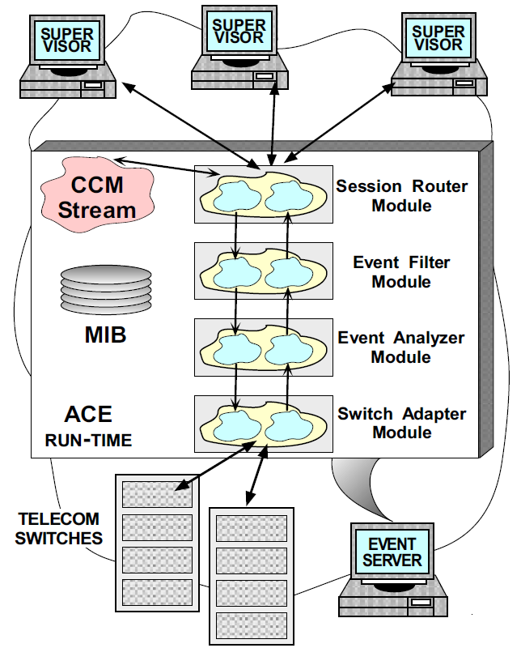
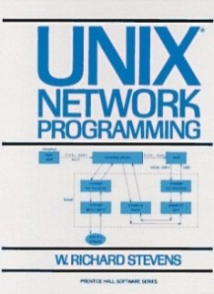

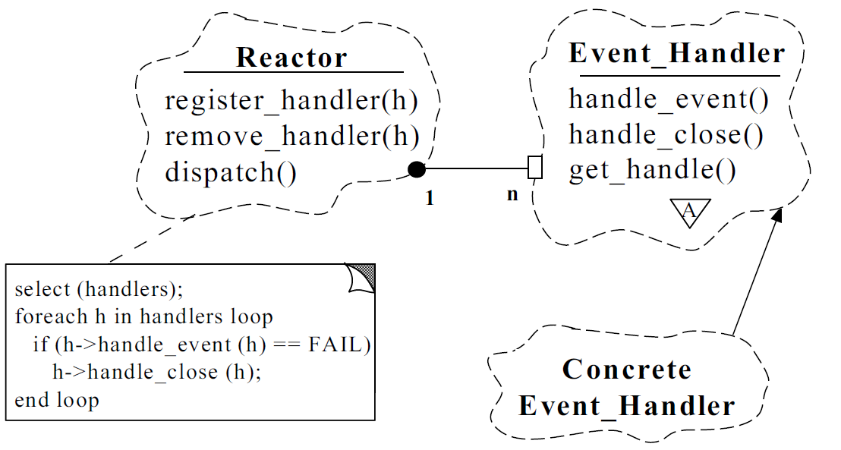
Becoming a Master Software Developer
Knowledge of programming languages is necessary, but not sufficient
Can fall prey to “featuritis” or worse!
Software methods emphasize design notations, such as UML
Fine for specification & documentation
But good software design is more than drawing diagrams
Good draftsmen/artists are not necessarily good architects!
Bottom-line: Master software developers rely on design experience
At least as important as knowledge of programming languages & environments
See www.dre.vanderbilt.edu/~schmidt/PDF/ECOOP-95.pdf for more info
Notes:
http://www.flickr.com/photos/60475145@N00/112577742/, http://www.flickr.com/photos/12967790@N00/196871101/

Slide 13
Where Should Design Experience Reside?
Well-designed software exhibits recurring structures & behaviors that promote
Abstraction
Flexibility
Reuse
Quality
Modularity
Notes:
http://en.wikipedia.org/wiki/File:PhrenologyPix.jpg

Slide 14

Where Should Design Experience Reside?
Well-designed software exhibits recurring structures & behaviors that promote
Abstraction
Flexibility
Reuse
Quality
Modularity
Therein lies valuable design knowledge

Slide 15
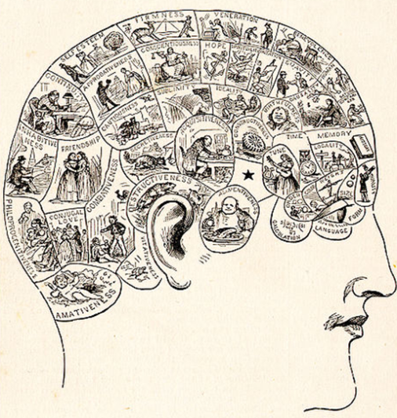
Where Should Design Experience Reside?
Well-designed software exhibits recurring structures & behaviors that promote
Abstraction
Flexibility
Reuse
Quality
Modularity
Therein lies valuable design knowledge
Unfortunately, this design knowledge is typically located in:
the heads of the experts
Notes:
http://en.wikipedia.org/wiki/File:PhrenologyPix.jpg

Slide 16
Where Should Design Experience Reside?
Well-designed software exhibits recurring structures & behaviors that promote
Abstraction
Flexibility
Reuse
Quality
Modularity
Therein lies valuable design knowledge
public class KeyGeneratorImpl extends Service {
private Set<UUID> keys = new HashSet<UUID>();
private final KeyGenerator.Stub binder = new KeyGenerator.Stub() {
public void setCallback (final KeyGeneratorCallback callback) {
UUID id;
synchronized (keys) {
do { id = UUID.randomUUID(); } while (keys.contains(id));
keys.add(id);
}
final String key = id.toString();
try {
Log.d(getClass().getName(), "sending key" + key);
callback.sendKey(key);
} catch (RemoteException e) { e.printStackTrace(); }
}
};
public IBinder onBind(Intent intent) { return this.binder; }
}
Unfortunately, this design knowledge is typically located in:
the heads of the experts
the bowels of the source code

Slide 17

Where Should Design Experience Reside?
Well-designed software exhibits recurring structures & behaviors that promote
Abstraction
Flexibility
Reuse
Quality
Modularity
Therein lies valuable design knowledge
Unfortunately, this design knowledge is typically located in:
the heads of the experts
the bowels of the source code
Both locations are fraught with danger!
Notes:
http://www.flickr.com/photos/93416311@N00/6979940655/

Slide 18
Summary
Achieving mastery of software development requires continuous repetition, practice, & mentoring from experts

Slide 19
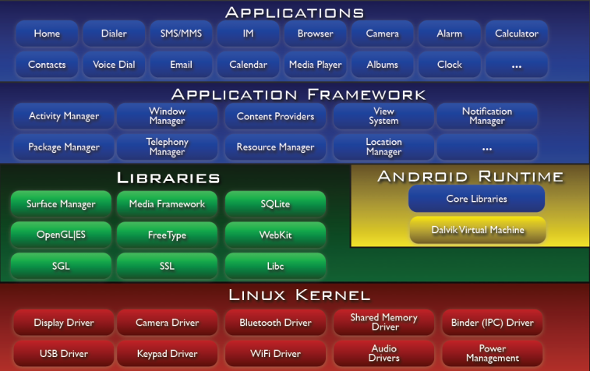
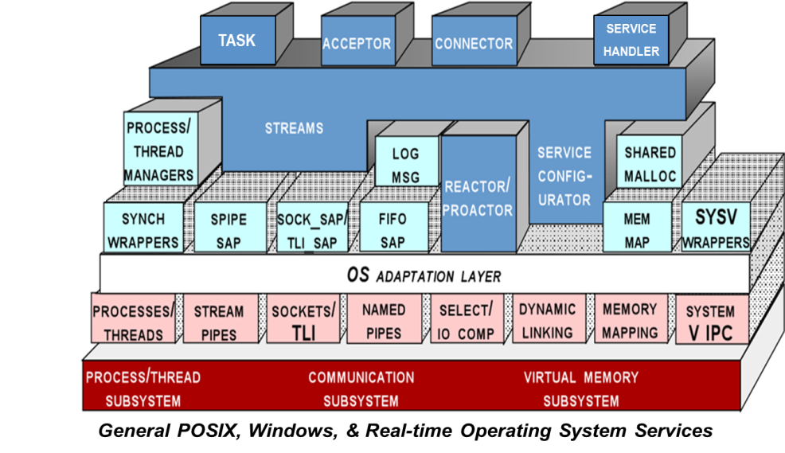
Summary
Achieving mastery of software development requires continuous repetition, practice, & mentoring from experts
Open-source & open courses are vital resources

Slide 20

Summary
Achieving mastery of software development requires continuous repetition, practice, & mentoring from experts
Open-source & open courses are vital resources

Slide 21
Summary
Achieving mastery of software development requires continuous repetition, practice, & mentoring from experts
Good software developers rely on experience gleaned from successful designs

Slide 22

Summary
Achieving mastery of software development requires continuous repetition, practice, & mentoring from experts
Good software developers rely on experience gleaned from successful designs
What we need is a means of extracting, documenting, conveying, applying, & preserving this design knowledge without undue time, effort, & risk!
Notes:
http://www.flickr.com/photos/30679003@N04/2957246492/

Slide 23


Overview of Patterns: Part 2
Douglas C. Schmidt
d.schmidt@vanderbilt.edu
www.dre.vanderbilt.edu/~schmidt
Professor of Computer Science
Institute for Software Integrated Systems Vanderbilt University Nashville, Tennessee, USA

Slide 24
Topics Covered in this Part of the Module
Enabling Systematic Reuse
Conveying Architectural Knowledge
Identifying & Name Recurring Structures & Behaviors
Codifying Design Expertise
Mapping Design Problems to Proven Solutions
…
Motivate the importance of design experience & leveraging recurring design structure in becoming a master software developer
Introduce patterns as a means of improving software quality & developer productivity by…
Pattern Concepts
Notes:
Another Flying sidekick, http://www.flickr.com/photos/34745138@N00/2756361218/

Slide 25
Topics Covered in this Part of the Module
Motivate the importance of design experience & leveraging recurring design structure in becoming a master software developer
Introduce patterns as a means of improving software quality & developer productivity
Summarize common characteristics of patterns
Subject
Observer
state
observerList
*
update
state = X;
notify();
setData
getData
notify
attach
detach
ConcreteObserver
Observer pattern
Observer pattern
update
doSomething
for all observers in observerList do
observer.update()
s->getData()
Notes:
Another Flying sidekick, http://www.flickr.com/photos/34745138@N00/2756361218/

Slide 26




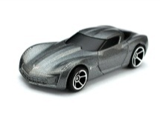
Key to Mastery: Knowledge of Software Patterns
Describes a solution to a common problem arising within a context
Aerospace
Civil engineering
Mobile devices
Automotive
Electronic Trading
Notes:
http://www.flickr.com/photos/35448539@N00/2378242121/, http://www.flickr.com/photos/50115004@N00/6941824942/, HotWheels - '09 Corvette Stingray Concept, http://www.flickr.com/photos/10581663@N08/4165107555/, http://www.flickr.com/photos/7617731@N02/3240810984/

Slide 27
Key to Mastery: Knowledge of Software Patterns
Describes a solution to a common problem arising within a context by
Naming a recurring design structure
Subject
Observer
Observer pattern
ConcreteObserver
Intent: “Define a one-to-many dependency between objects so that when one object changes state, all dependents are notified & updated”

Slide 28
Key to Mastery: Knowledge of Software Patterns
Describes a solution to a common problem arising within a context by
Naming a recurring design structure
Specifying design structure explicitly by identifying key class/object
Roles & relationships
Dependencies
Interactions
Conventions
Subject
Observer
state
observerList
*
update
*
state = X;
notify();
setData
getData
notify
attach
detach
Observer pattern
ConcreteObserver
update
doSomething
for all observers in observerList do
observer.update()
s->getData()
*Interpret “class” & “object” loosely: patterns are for more than OO languages!

Slide 29


Key to Mastery: Knowledge of Software Patterns
Describes a solution to a common problem arising within a context by
Naming a recurring design structure
Specifying design structure explicitly by identifying key class/object
Roles & relationships
Dependencies
Interactions
Conventions
Abstracting from concrete design elements, e.g., problem domain, form factor, vendor, etc.
Subject
Observer
state
observerList
*
update
state = X;
notify();
setData
getData
notify
attach
detach
Observer pattern
ConcreteObserver
update
doSomething
for all observers in observerList do
observer.update()
s->getData()
Notes:
http://www.flickr.com/photos/35448539@N00/2378242121/, http://www.flickr.com/photos/26097071@N05/5356419464/

Slide 30


Key to Mastery: Knowledge of Software Patterns
Describes a solution to a common problem arising within a context by
Naming a recurring design structure
Specifying design structure explicitly by identifying key class/object
Roles & relationships
Dependencies
Interactions
Conventions
Abstracting from concrete design elements, e.g., problem domain, form factor, vendor, etc.
Distilling & codifying knowledge gleaned by experts from their successful design experiences
Subject
Observer
state
observerList
*
update
state = X;
notify();
setData
getData
notify
attach
detach
Observer pattern
ConcreteObserver
update
doSomething
for all observers in observerList do
observer.update()
s->getData()

Slide 31


Common Characteristics of Patterns
They are independent of programming languages & implementation techniques

Slide 32
Common Characteristics of Patterns
They are independent of programming languages & implementation techniques
They define “micro-architectures”
i.e., recurring design structure
Subject
Observer
state
observerList
*
update
state = X;
notify();
setData
getData
notify attach
detach
ConcreteObserver
update
doSomething
for all observers in observerList do
observer.update()
s->getData()

Slide 33
Common Characteristics of Patterns
They are independent of programming languages & implementation techniques
They define “micro-architectures”
i.e., recurring design structure
They aren’t code or (concrete) designs, so they must be reified & applied in particular languages
public class EventHandler extends Observer {
public void update(Observable o, Object arg) { /*…*/ }
…
public class EventSource extends Observable, implements Runnable { public void run()
{ /*…*/ notifyObservers(/*…*/); }
…
EventSource eventSource = new EventSource();
EventHandler eventHandler = new EventHandler();
eventSource.addObserver(eventHandler);
Thread thread = new Thread(eventSource);
thread.start();
…
Observer pattern in Java

Slide 34
Common Characteristics of Patterns
They are independent of programming languages & implementation techniques
They define “micro-architectures”
i.e., recurring design structure
They aren’t code or (concrete) designs, so they must be reified & applied in particular languages
class Event_Handler : public Observer { public:
virtual void update(Observable o, Object arg) { /* … */ }
…
class Event_Source : public Observable, public ACE_Task_Base { public:
virtual void svc()
{ /*…*/ notify_observers(/*…*/); }
…
Observer pattern in C++/ACE
(uses the GoF Bridge pattern with reference counting to simplify memory management & ensure exception-safe semantics)
Event_Source event_source;
Event_Handler event_handler;
event_source->add_observer(event_handler);
Event_Task task (event_source);
task->activate();
…

Slide 35


Common Characteristics of Patterns
They are independent of programming languages & implementation techniques
They define “micro-architectures”
i.e., recurring design structure
They aren’t code or (concrete) designs, so they must be reified & applied in particular languages
They are not methods, but can be used an adjunct to other methods
e.g., Rational Unified Process, Agile, etc.

Slide 36
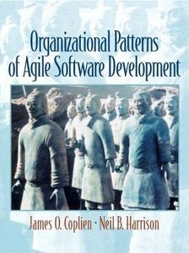

Common Characteristics of Patterns
They are independent of programming languages & implementation techniques
They define “micro-architectures”
i.e., recurring design structure
They aren’t code or (concrete) designs, so they must be reified & applied in particular languages
They are not methods, but can be used an adjunct to other methods
e.g., Rational Unified Process, Agile, etc.
There are also patterns for organizing effective software development teams & navigating other complex settings

Slide 37
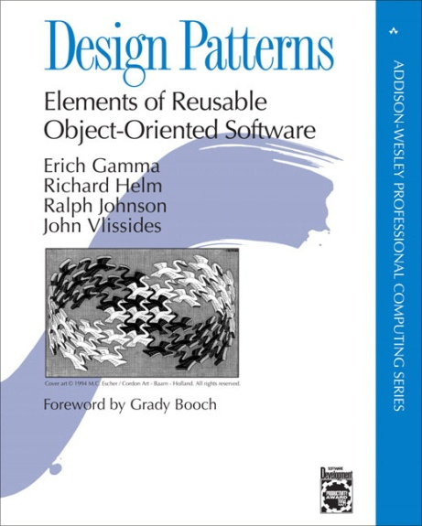


Common Parts of a Pattern Description
Name & statement of pattern intent
Problem addressed by pattern
Including “forces” & “applicability”
Solution
Visual & textual descriptions of pattern structure & dynamics
Examples & Implementation guidance
May include source code snippets
Consequences
Pros & cons of applying the pattern
Known uses
“Rule of three”
Related patterns
Tradeoffs between alternative patterns
See c2.com/cgi/wiki?PatternForms for more info on pattern forms

Slide 38
Summary
Patterns support design at a more abstract level than code
Emphasize design qua design, not (obscure) language features
Treat class/object interactions as a cohesive conceptual unit
Provide ideal targets for design & implementation refactoring
e.g., adapters & (wrapper) facades
Subject
Observer
state
observerList
*
update
state = X;
notify();
setData
getData
notify
attach
detach
Observer pattern
ConcreteObserver
update
doSomething
for all observers in observerList do
observer.update()
s->getData()

Slide 39
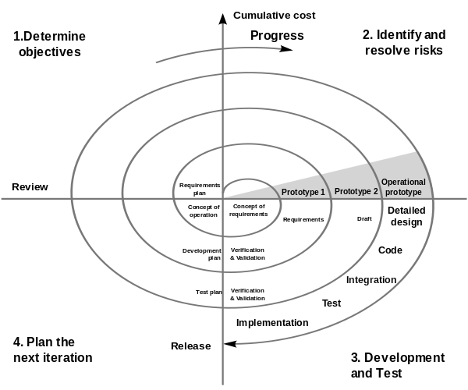
Summary
Patterns support design at a more abstract level than code
Emphasize design qua design, not (obscure) language features
Treat class/object interactions as a cohesive conceptual unit
Provide ideal targets for design & implementation refactoring
e.g., adapters & (wrapper) facades
Patterns can be applied in all software lifecycle phases
Analysis, design, & reviews
Implementation & optimization
Testing & documentation
Reuse & refactoring
Patterns often equated with OO languages, but can apply to non-OO languages
Notes:
http://en.wikipedia.org/wiki/File:Spiral_model_(Boehm,_1988).svg

Slide 40
Overview of Patterns: Part 3
Douglas C. Schmidt
d.schmidt@vanderbilt.edu
www.dre.vanderbilt.edu/~schmidt
Professor of Computer Science
Institute for Software Integrated Systems Vanderbilt University Nashville, Tennessee, USA

Slide 41
Topics Covered in this Part of the Module
Motivate the importance of design experience & leveraging recurring design structure in becoming a master software developer
Introduce patterns as a means of improving software quality & developer productivity
Summarize common characteristics of patterns
Describe a variation-oriented process for successfully applying patterns to software development projects
Pattern Knowledge
Trade-off Analysis
Design & Implementation Decisions
Implement & Integrate Patterns & Code
Notes:
Another Flying sidekick, http://www.flickr.com/photos/34745138@N00/2756361218/

Slide 42
Variation-oriented Process for Applying Patterns
To apply patterns successfully, software developers need to:
Have broad knowledge of patterns relevant to their domain(s)
Chain of Responsibility
Bridge
Facade
Interpreter
Proxy
Adapter
Adapter
See www.dre.vanderbilt.edu/~schmidt/PDF/ORB-patterns.pdf for more info

Slide 43




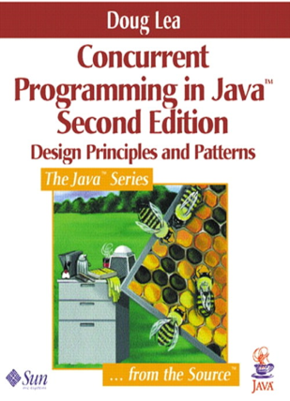







Variation-oriented Process for Applying Patterns
To apply patterns successfully, software developers need to:
Have broad knowledge of patterns relevant to their domain(s)

Slide 44
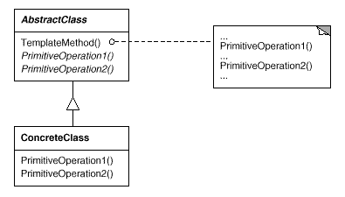
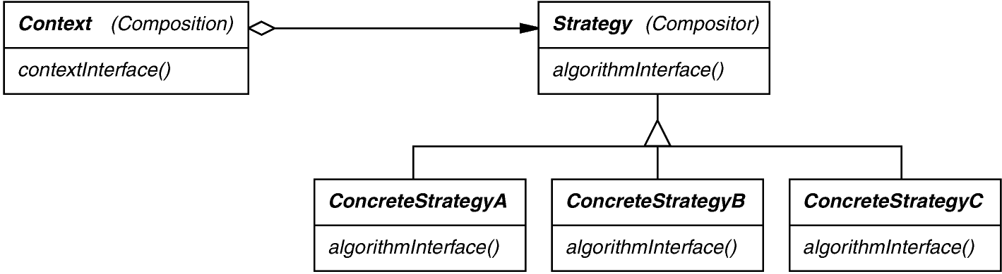
Variation-oriented Process for Applying Patterns
To apply patterns successfully, software developers need to:
Have broad knowledge of patterns relevant to their domain(s)
Evaluate trade-offs & impact of using certain patterns in their software
Template Method pattern
?
?
Strategy pattern

Slide 45
Variation-oriented Process for Applying Patterns
To apply patterns successfully, software developers need to:
Have broad knowledge of patterns relevant to their domain(s)
Evaluate trade-offs & impact of using certain patterns in their software
Make design & implementation decisions about how best to apply the selected patterns
Patterns may require modifications for particular contexts
Subject
Observer
state
observerList
*
update
attach
detact
notify
ConcreteObserver
update
…
for all observers in observerList do
observer.update()
The Observer Pattern

Slide 46
Variation-oriented Process for Applying Patterns
To apply patterns successfully, software developers need to:
Have broad knowledge of patterns relevant to their domain(s)
Evaluate trade-offs & impact of using certain patterns in their software
Make design & implementation decisions about how best to apply the selected patterns
Patterns may require modifications for particular contexts
Observer
Observer
Subject
Observer
Content Observable
Content
Observer
state
observerList
*
onChange
registerObserver
unregisterObserver
notifyChange
MyContent Observer
onChange
…
for all observers in observerList do
observer.onChange()
Concrete
Observer
One use of the Observer Pattern in Android
Observer

Slide 47
Variation-oriented Process for Applying Patterns
To apply patterns successfully, software developers need to:
Have broad knowledge of patterns relevant to their domain(s)
Evaluate trade-offs & impact of using certain patterns in their software
Make design & implementation decisions about how best to apply the selected patterns
Patterns may require modifications for particular contexts
Observer
Observer
Subject
Observer
Context
Broadcast Receiver
state
observerList
*
onReceive
registerReceiver
unregisterReceiver
sendBroadcast
BroadcastHandler
onReceive
…
for all observers in observerList do
observer.onReceive()
Concrete
Observer
A different use of the Observer Pattern in Android
Observer

Slide 48
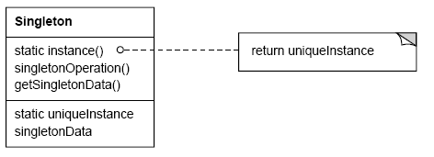
Variation-oriented Process for Applying Patterns
To apply patterns successfully, software developers need to:
Have broad knowledge of patterns relevant to their domain(s)
Evaluate trade-offs & impact of using certain patterns in their software
Make design & implementation decisions about how best to apply the selected patterns
Patterns may require modifications for particular contexts
If (uniqueInstance == 0)
uniqueInstance = new Singleton;
return uniqueInstance;
Singleton pattern
John Vlissides, “To Kill a Singleton”
www.research.ibm.com/ designpatterns/pubs/ph-jun96.txt

Slide 49
Variation-oriented Process for Applying Patterns
To apply patterns successfully, software developers need to:
Have broad knowledge of patterns relevant to their domain(s)
Evaluate trade-offs & impact of using certain patterns in their software
Make design & implementation decisions about how best to apply the selected patterns
Patterns may require modifications for particular contexts
If (uniqueInstance == 0)
uniqueInstance = new Singleton;
return uniqueInstance;
Singleton pattern vs. Double-Checked Locking Pattern
class Singleton {
private static Singleton inst = null;
public static Singleton instance() {
Singleton result = inst;
if (result == null) {
inst = result = new Singleton();
}
return result;
}
...
Too little synchronization

Slide 50
Variation-oriented Process for Applying Patterns
To apply patterns successfully, software developers need to:
Have broad knowledge of patterns relevant to their domain(s)
Evaluate trade-offs & impact of using certain patterns in their software
Make design & implementation decisions about how best to apply the selected patterns
Patterns may require modifications for particular contexts
If (uniqueInstance == 0)
uniqueInstance = new Singleton;
return uniqueInstance;
Singleton pattern vs. Double-Checked Locking Pattern
class Singleton {
private static Singleton inst = null;
public static Singleton instance() {
synchronized(Singleton.class) {
Singleton result = inst;
if (result == null) {
inst = result = new Singleton();
}
}
return result;
}
...
Too much synchronization

Slide 51
Variation-oriented Process for Applying Patterns
To apply patterns successfully, software developers need to:
Have broad knowledge of patterns relevant to their domain(s)
Evaluate trade-offs & impact of using certain patterns in their software
Make design & implementation decisions about how best to apply the selected patterns
Patterns may require modifications for particular contexts
If (uniqueInstance == 0)
uniqueInstance = new Singleton;
return uniqueInstance;
Singleton pattern vs. Double-Checked Locking Pattern
class Singleton {
private static volatile Singleton
inst = null;
public static Singleton instance() {
Singleton result = inst;
if (result == null) {
synchronized(Singleton.class) {
result = inst;
if (result == null)
{ inst = result = new Singleton(); }
}
}
return result;
...
Just right amount of synchronization

Slide 52
Variation-oriented Process for Applying Patterns
To apply patterns successfully, software developers need to:
Have broad knowledge of patterns relevant to their domain(s)
Evaluate trade-offs & impact of using certain patterns in their software
Make design & implementation decisions about how best to apply the selected patterns
Patterns may require modifications for particular contexts
If (uniqueInstance == 0)
uniqueInstance = new Singleton;
return uniqueInstance;
Singleton pattern vs. Double-Checked Locking Pattern
class Singleton {
private static volatile Singleton
inst = null;
public static Singleton instance() {
Singleton result = inst;
if (result == null) {
synchronized(Singleton.class) {
result = inst;
if (result == null)
{ inst = result = new Singleton(); }
}
}
return result;
...
Solution only works in JDK5 & above
See en.wikipedia.org/wiki/Double-checked_locking for more info

Slide 53
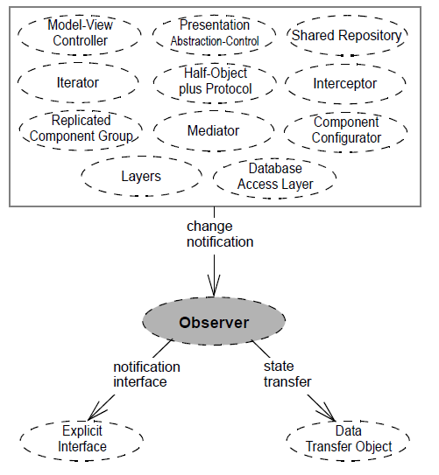
Variation-oriented Process for Applying Patterns
To apply patterns successfully, software developers need to:
Have broad knowledge of patterns relevant to their domain(s)
Evaluate trade-offs & impact of using certain patterns in their software
Make design & implementation decisions about how best to apply the selected patterns
Patterns may require modifications for particular contexts
Combine with other patterns & implement/integrate with code
High pattern
density

Slide 54
Summary
Patterns support a variation-oriented design process
Determine which design elements can vary
Identify applicable pattern(s)
Vary patterns & evaluate trade-offs
Repeat…
Pattern Knowledge
Trade-off Analysis
Design & Implementation Decisions
Implement & Integrate Patterns & Code

Slide 55

Summary
Patterns support a variation-oriented design process
Determine which design elements can vary
Identify applicable pattern(s)
Vary patterns & evaluate trade-offs
Repeat…
Don’t brand everything as a pattern
Articulate specific benefits & demonstrate general applicability
e.g., find 3 different existing examples from code other than yours!

